Slide 1
AN EFFICIENT METHOD OF SPEECH TO TEXT CONVERSION FOR AUDIO FILES,INCLUDING SEARCH ENGINE AND NEWABLE TECHNIQUE FOR PHYSICALLY DISABLED
Submitted by,
DHILRUBAN K.S
DINESH K
DINESH KRISHNA P
ESWAR K.V
Guided by,
Mr.R.jayaraj

Slide 2
AIM
Speech recognition is the ability of a machine or program to identify words and phrases in spoken format
speech recognition software has a limited vocabulary of words and phrases, and it may only identify these if they are spoken very clearly.

Slide 3
PROJECT IDEA
We will convert audio file and voice to text format
We will create search engine using voice recognition
We will convert speech to text and text to speech format and show the output in notepad for physical challenged persons

Slide 4
EXISTING SYSTEM
SPEECH RECOGNITION
The existing system of voice to text recognition is only convert
Voice or speech to text format.
It required more time to convert the text.
Previously its used only for physical challenged people.

Slide 5
PROPOSED WORK
Using python programming language to convert voice to text format in efficiently
Also convert the voice recognition into audio file format
It can also recognize the voice format and search for it regardingly
Output of the process which is done , can be displayed in website

Slide 6
HARDWARE REQUIREMENTS
Processor :i3
Hard Disk :5GB
Memory :1GB
High speed Internet connection
Microphone

Slide 7
SOFTWARE REQUIREMENTS
Operating System :Windows
Programing language :Python
Website Style :HTML,CSS,JAVASCRIPT
Server : APACHE Server

Slide 8
MODULE DESCRIPTION
Module 1:
We used python program to convert voice to text format and created our website using HTML and CSS
Module 2:
Recognize voice module
Module 3:
Speech to text module

Slide 9
Module 3:
Voice to text module
Module 4:
Audio recording module
Module 5:
Search engine module

Slide 10
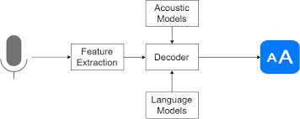
SPEECH TO TEXT CONVERSION

Slide 11
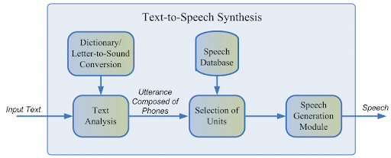
TEXT TO SPEECH CONVERSION

Slide 12
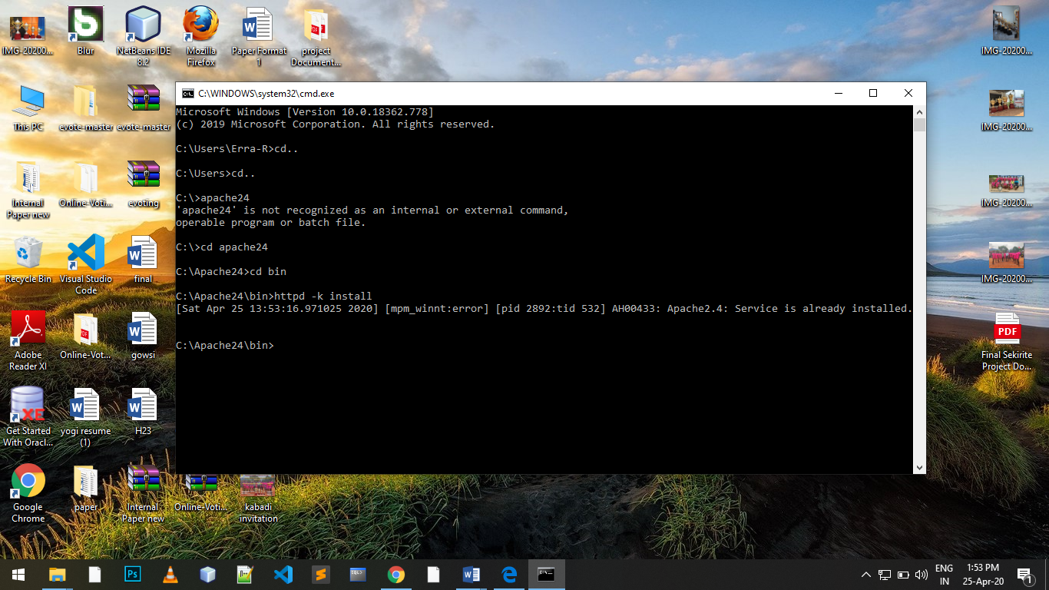
SCREENSHOTS
Apache Server

Slide 13
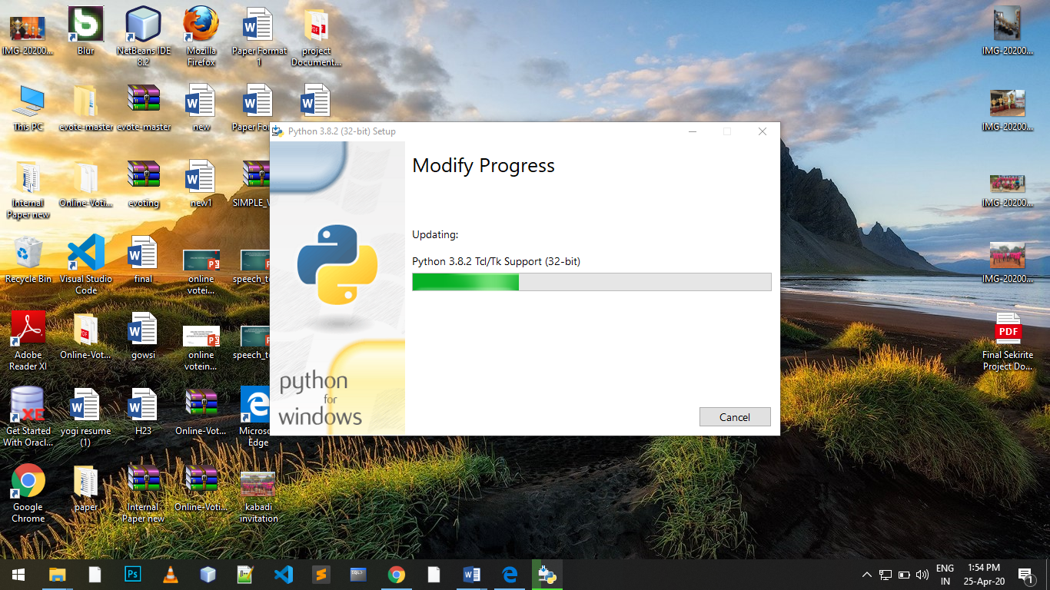
Python Installation

Slide 14
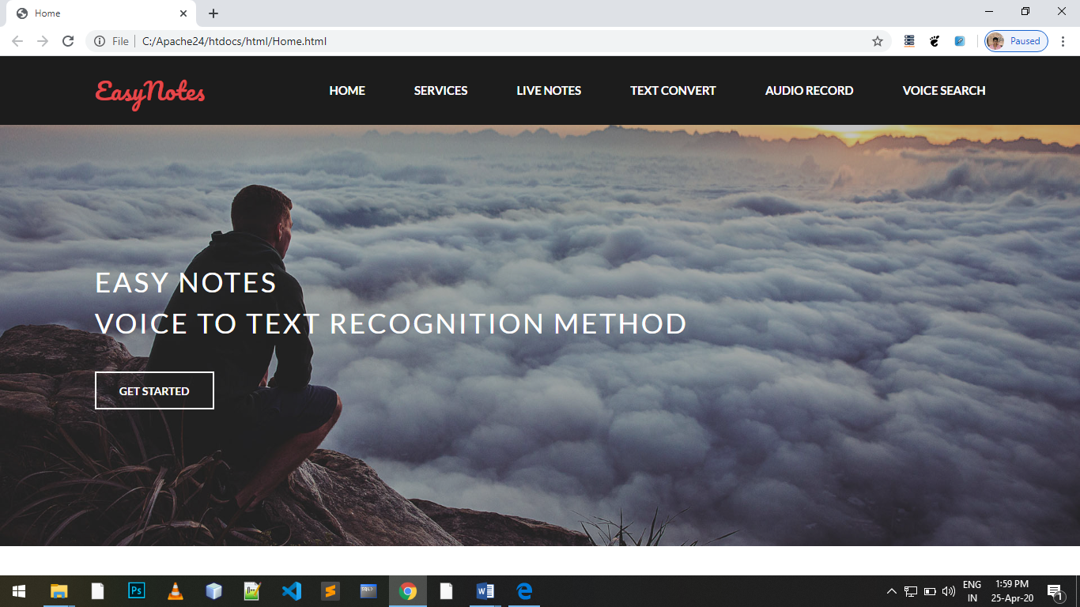
Home Page

Slide 15
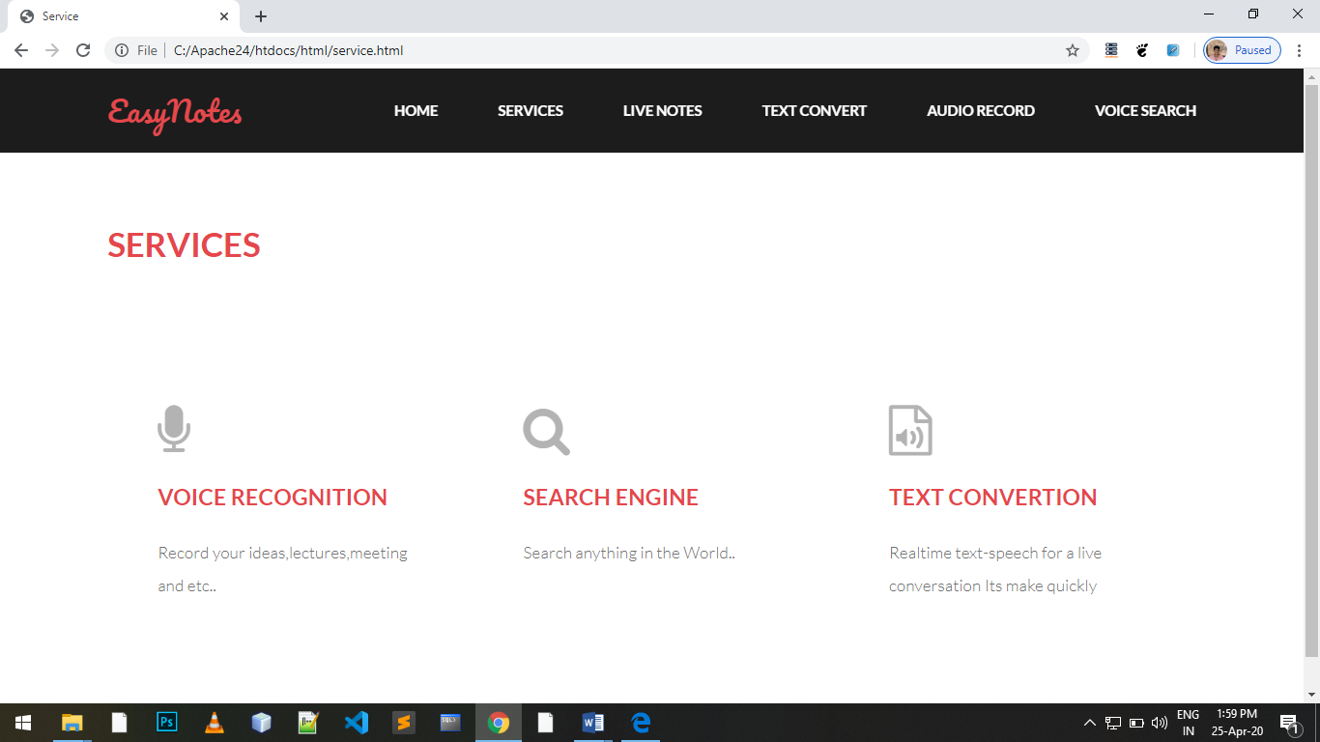
Services

Slide 16
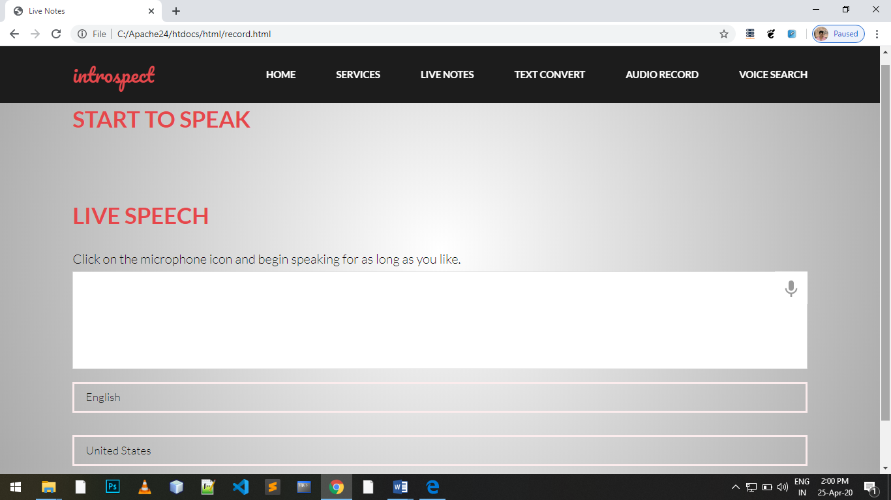
Speech to Text

Slide 17
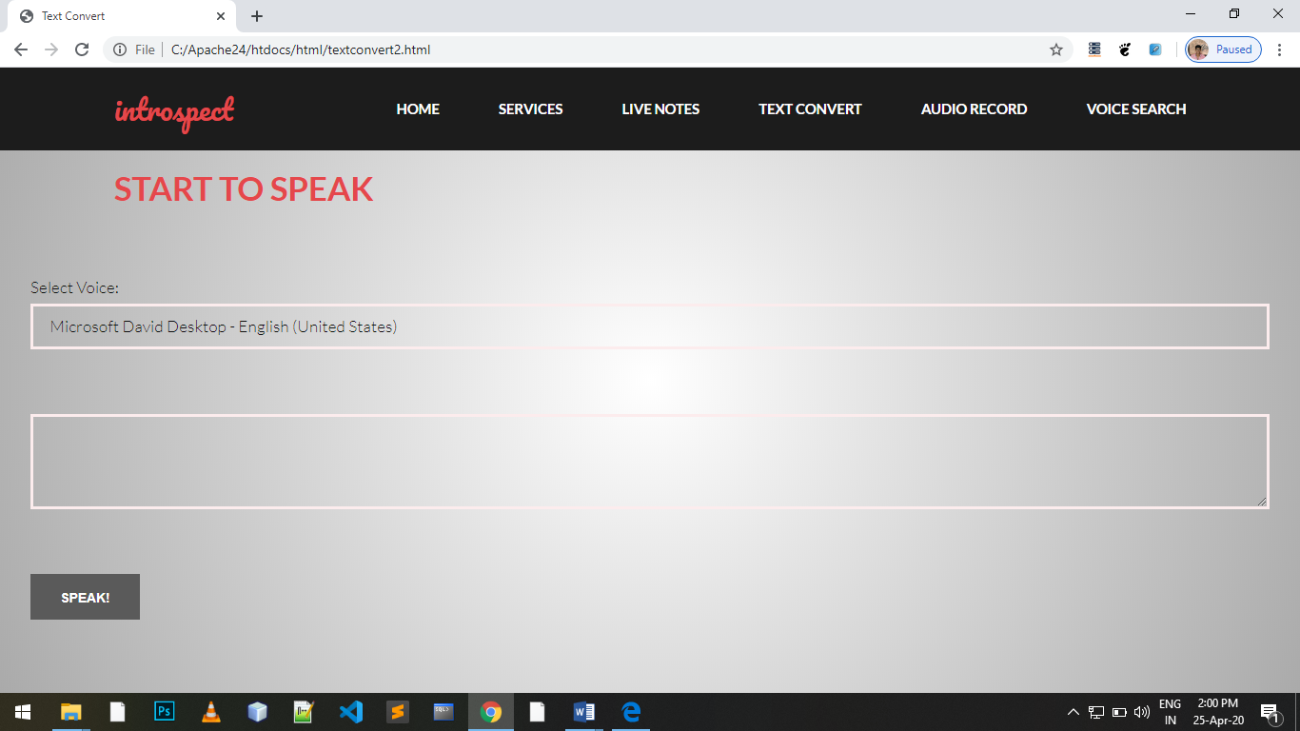
Text to Speech

Slide 18
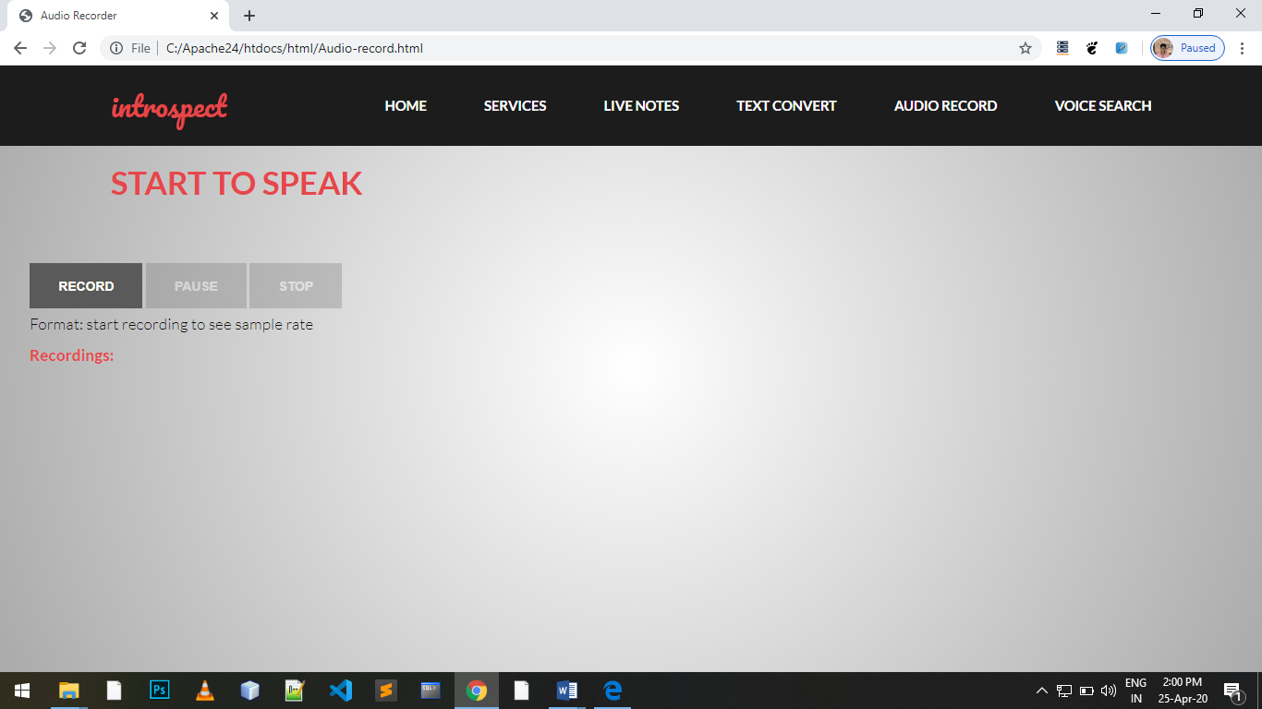
Audio Record

Slide 19
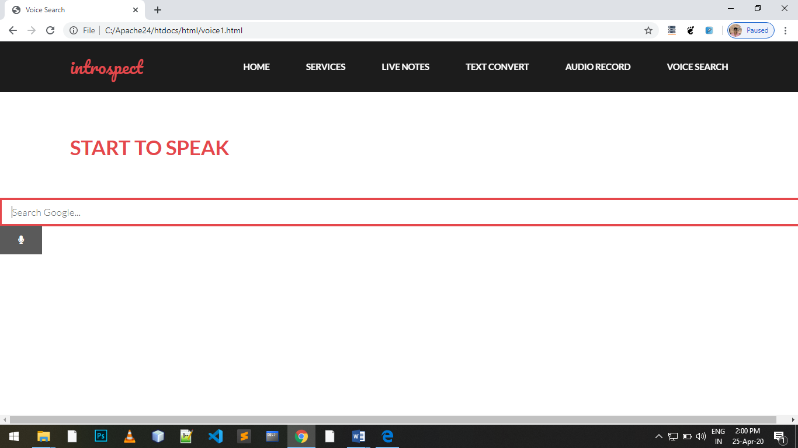
Search Engine

Slide 20
FUTURE WORK
convert video file into text format
to Developed as a mobile application
The system may be enhanced to make work for online mode by integrating it in web applications.
The system can be enhanced to apply on the real time applications using telephone

Slide 21
CONCLUSION
Speech Recognition has become very important in today’s world. With the advancements in technology and improvements in recognition algorithms, speech has become one of the primary source of input for many applications.
we presented an idea for the development of an IVR system with Automatic Speech Recognition (ASR). The initial objective of the project was to develop a system capable of recognizing voice signals in All Language input to the IVR system.

Slide 22
THANK YOU

